Slide 1

动态程序设计与智能系统开发 Dynamic Programming & Intelligent Systems
Haikuan Li, Visiting Professor
CLEBA Group, Delfgauw,
The Netherlands
Notes:
The title of the course is “Software Development Paradigm in the Era of Big Data”.

Slide 2
Reference
H. Li “Software Development of Datafication, Intelligence, Architecturalization and Intensification”, Lecture Notes for the Seminar on Leading Software Technology, Nankai University, Tianjin, China, Sept 2020
H. Li, “Seminar Series of Cutting-Edge Software Technologies” Lecture Notes edited for the Course in Northwest Polytechnical University. CLEBA Group, Netherlands, 2019-2021
H. Li, “Software Development Paradigm in the Era of Big Data”, Lecture Note edited for the course only in University of Chinese Academy of Sciences. CLEBA Group, Netherlands, Jul. 2016
H. Li, Z. Dong ,Y. Wei, “Dynamic Software Programming”, Computer Engineering Design, 1989-2 **
Claudius Gros, ”Complex and Adaptive Dynamical Systems”, Springer,4th ed. 2015
**李海宽,董占球,魏源瑞,“动态程序设计”计算机工程与设计,1989-2
Notes:
李海宽 董占球 魏源瑞 “动态程序设计”《计算机工程设计>, 1989-2
李海宽，“软件开发的数据化、智能化、架构化、集约化”, 课程讲稿，南开大学，天津，2020年9月

Slide 3
Content
Natural Intelligence (NI)
Intelligence demonstrated by machines[wiki].
Artificial Intelligence (AI)
Intelligence displayed by animals including humans[wiki].
Intelligent Components
A System component with NI, AI or NI&AI
Intelligent System
A System that contains one or more intelligent components
Dynamic Architecture
A System architecture that may be changed during runtime.
Intelligent System::= Architecture + Intelligent Components
An constructive Definition
The Features of Intelligent Systems
What are the characteristics of Intelligent System.
Intelligent System Development
Dynamic Computer Programming

Slide 4
Intelligent System
Intelligent system as an advanced machine that perceive and respond to the world around them, e.g.
Automated vacuums such as the Roomba,
Facial recognition programs and
Amazon's personalized shopping suggestions. wiki
Intelligent system as an advanced application that incorporates intelligence into applications being handled by machines, e.g.
Search and optimization
Learning capabilities. wiki
Intelligent system as software defined things that have artificial intelligence inside, natural intelligence behind or their combination.
Mobile in your hand
Internet Service

Slide 5
Intelligent System
Intelligence can refer to both artificial intelligence (AI) and natural intelligence (NI). Artificial intelligence refers to the ability of machines to perform tasks that typically require human intelligence, such as recognizing speech, identifying objects, or making decisions. Natural intelligence, on the other hand, refers to the intelligence possessed by biological organisms, including humans and animals.
Intelligent systems can incorporate both AI and NI. For example, a self-driving car might use AI algorithms to recognize objects and make decisions, but it also relies on the natural intelligence of the human programmers who created its algorithms and the human drivers who provide feedback to improve its performance. Similarly, a virtual assistant like Siri or Alexa uses AI algorithms to understand natural language and respond to user queries, but it also relies on the natural intelligence of the developers who designed its algorithms and the users who provide feedback to improve its performance.
In summary, intelligent systems can incorporate both artificial intelligence and natural intelligence, and the two types of intelligence can work together to create more effective and sophisticated systems.

Slide 6
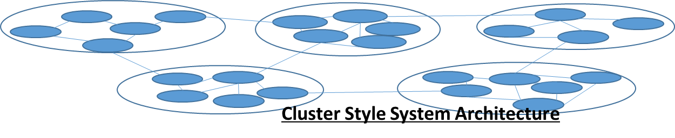
Intelligent Programming
Intelligent Programming is dynamic programming with a set of Intelligent components. In other words, an intelligent system consists of a set of intelligent components and the interconnections between them, namely,
Intelligent System ::= Architecture + Intelligent Components

Slide 7
System = Architecture + Components
Structured: “Anything that has been put together in an organized, deliberate way can be described as structured.” -- Vocabulary.com
<System> ::= Architecture + Components (Very-High-Level Programming)
<System> ::= Architecture + Static Components (Static Programming)
<System> ::= Architecture + Active Components (Dynamic Programming)
<System> ::= Architecture + Intelligent Components (Intelligent Programming)

Slide 8
Intelligent Component
Component: A constituent part of a system.
Static Component：Programing Language constructions and their composition
Active Component: Processes or software defined things in running status
Intelligent Component: Active components with artificial or natural intelligent behind.

Slide 9
Intelligent Architecture
Architecture: An organizational structure of a system, about how the system components are organized together to form the system.
Static Architecture: System architecture that won’t be changed during system execution.
Dynamic Architecture is a kind of system architecture that is changed during the system execution, including adding new components and losing the existing once's , as well as changing the connections between components.
Intelligent Architecture: An intelligent architecture is a dynamic architecture about a set of intelligent components and the relationships between them, and the architectural changes during system execution are well modeled and planned based-on an intelligent way.

Slide 10
Intelligent Components
An intelligent component is an active component with AI or NI behind, which are characterized by multiple features as following:
Autonomous: The system components are active components that are running in advance autonomously.
Implementation Independent: The implementation of system components is hided from the system. Every system component is a black box used for system development.
Integration: An running software component may be an integration of a set of lower-level components or complex logics.
Dynamics: A component may join or withdraw from the system dynamically.
Evolution: The quality of the components may be evolving dynamically so that to be adaptive to changing business and technical environment.
Uncertainty: The status of the component with uncertainty.
User Inclusive: The users can be software defined things or active components of the system.
Intelligence: The components may have natural or artificial Intelligence behind.

Slide 11

Q&A

Slide 12
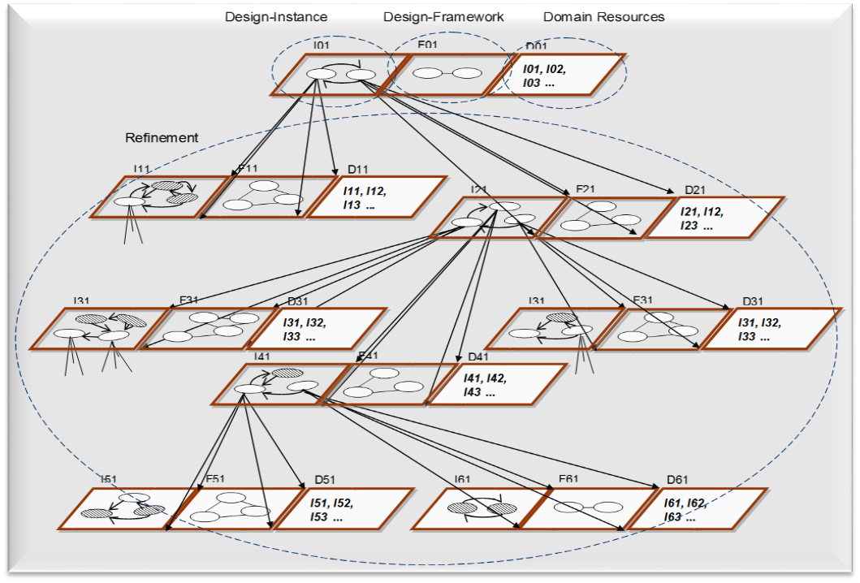
Modeling Domain Architecture

Slide 13
Modelling the Activities of System Construction
Decomposition
Aggregation
Generalization
Specialization

Slide 14
Modeling Forward & Reverse Engineering
Three pairs of operators
Aggregation ⬄ Decomposition,
Generalization ⬄ Specialization,
Parameterization ⬄ Instantiation
Forward Engineering
Aggregation: Architecture + {Component} => Component (1) Recursive
Decomposition: Component => Architecture + {Component} (2) Recursive
Specialization: Component => Component (3)
Instantiation: Architecture, {Component} => Component (4)
Reverse Engineering:
Aggregation
Decomposition,
Generalization: Component => Component (5)
Parameterization: Component => Architecture, {Component} (6)

Slide 15
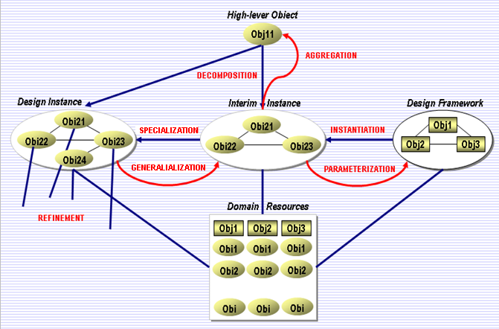
Organizational vs Operational Model
Organization Model
Operation Model

Slide 16
Architecture-Based Software Development

Slide 17


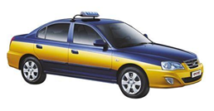

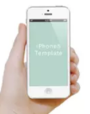


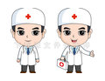
Software Defined Things & Internet Services
Printer
Radio
Computer
Teacher
Doctor
Person
Shop
Company
……

Slide 18
Software Defined Things (Example)
Software Defined Thing is an abstraction of the thing, with combination of internet the object may be managed or manipulated via software. E.g.
Software-defined data center
Software-defined infrastructure
Software-defined mobile network
Software-defined networking
Software-defined projector
Software-defined radio
Software Defined Printer,
Software Defined Doctor
Software Defined Taxi
Software Defined Friends
Software Defined Meeting
Software Defined Computer
Software Defined Seattleite

Slide 19
Software Defined Thing with Multiple Views
Software Defined Thing in multiple views. The same thing may be defined as multiple things based-on multiple views of the thing.
E.g. A person may be defined as
A child of his parents.
A grandson of his grandparents.
A father of his children
A doctor
A football player
A piano player
A customer
……..

Slide 20
Internet of Things (Examples)
The Internet of Things (IoT) describes the network of physical objects—“things”—that are embedded with sensors, software, and other technologies for the purpose of connecting and exchanging data with other devices and systems over the internet.[1][2][3][4]. [wiki]
Internet of homes
Internet of restaurants
Internet of people
Internet of Taxis
Internet of Universities
Internet of Doctors
Internet of Courses
Internet of Animals
Internet of Shops
Internet of Games
Reference
Rouse, Margaret (2019). "internet of things (IoT)". IOT Agenda. Retrieved 14 August 2019.
^ Brown, Eric (20 September 2016). "21 Open Source Projects for IoT". Linux.com. Retrieved 23 October 2016.
^ "Internet of Things Global Standards Initiative". ITU. Retrieved 26 June 2015.
^ Hendricks, Drew. "The Trouble with the Internet of Things". London Datastore. Greater London Authority. Retrieved 10 August 2015.

Slide 21
Developing a Network Style Intelligent System
Dynamic programming with a set of intelligent components and a network style dynamic architecture, resulting an intelligent system.
Intelligent Components refers to active components that perceive and respond to the world around. Intelligent refers to both natural intelligent, artificial intelligent and their combination, for example , the software defined robots, humans, animals, taxis and airplanes. An intelligent component may also a composition of a set of closely related lower-level intelligent components.
Network Style Architecture
+ Intelligent Components
= Intelligent System

Slide 22
Cluster-Based Intelligent System
Intelligent System ::= Dynamic Architecture + Intelligent Components
Intelligent Component = Service or Software Defined thing
Intelligent Component = Services + Software Defined Things (Cluster)

Slide 23
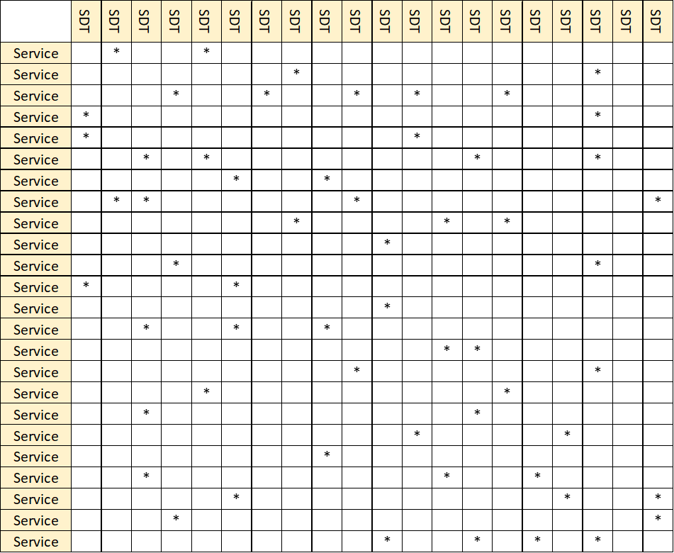
Internet System View <Internet Services> x <Software Defined Things>
Initial View
Optimized View
 | SDT | SDT | SDT | SDT | SDT | SDT | SDT | SDT | SDT | SDT | SDT | SDT | SDT | SDT | SDT | SDT | SDT | SDT | SDT | SDT
Service |  |  |  |  | * |  |  |  |  |  |  | *
Service |  |  | * |  |  |  | *
Service |  |  |  | * |  |  |  |  |  | * |  |  |  |  | *
Service |  |  |  |  |  |  |  |  |  |  |  |  |  |  |  | * |  |  | *
Service |  |  |  |  |  |  |  | *
Service |  |  | * |  |  |  |  |  |  |  |  |  |  |  |  |  |  | *
Service |  |  |  |  |  | *
Service |  |  |  |  |  |  |  |  |  | * |  |  |  |  |  |  |  |  |  | *
Service |  | * |  |  |  |  |  |  |  |  |  |  | *
Service |  |  |  |  |  |  | * |  |  |  | *
Service |  |  |  | * |  |  |  |  |  |  |  |  |  |  |  |  | *
Service | * |  |  |  | *
Service |  |  |  |  | * |  |  |  | * |  | *
Service |  |  |  |  |  | * |  |  |  |  |  |  |  |  |  |  | *
Service |  |  |  |  |  |  |  |  |  |  |  |  | *
Service |  |  |  |  |  |  |  |  |  | * |  |  |  |  |  |  |  | * | *
Service |  |  |  |  | *
Service |  |  |  |  |  |  |  | *
Service |  |  |  |  |  |  |  |  |  |  |  | * |  |  |  | *
Service |  |  |  |  |  |  |  |  |  |  |  |  |  |  | *
Service |  |  |  |  |  |  |  |  |  |  |  |  | *
Service |  |  |  |  |  | * |  |  |  |  |  |  |  |  |  |  |  | * |  | *
Service |  |  |  |  |  |  | *
 |  |  |  |  |  |  |  |  |  |  |  |  |  | *
 | SDT | SDT | SDT | SDT | SDT | SDT | SDT | SDT | SDT | SDT | SDT | SDT | SDT | SDT | SDT | SDT | SDT | SDT | SDT | SDT
Service |  |  |  |  | * |  |  |  |  |  |  | *
Service |  |  | * |  |  |  | *
Service |  |  |  | * |  |  |  |  |  | * |  |  |  |  | *
Service |  |  |  |  |  |  |  |  |  |  |  |  |  |  |  | * |  |  | *
Service |  |  |  |  |  |  |  | *
Service |  |  | * |  |  |  |  |  |  |  |  |  |  |  |  |  |  | *
Service |  |  |  |  |  | *
Service |  |  |  |  |  |  |  |  |  | * |  |  |  |  |  |  |  |  |  | *
Service |  | * |  |  |  |  |  |  |  |  |  |  | *
Service |  |  |  |  |  |  | * |  |  |  | *
Service |  |  |  | * |  |  |  |  |  |  |  |  |  |  |  |  | *
Service | * |  |  |  | *
Service |  |  |  |  | * |  |  |  | * |  | *
Service |  |  |  |  |  | * |  |  |  |  |  |  |  |  |  |  | *
Service |  |  |  |  |  |  |  |  |  |  |  |  | *
Service |  |  |  |  |  |  |  |  |  | * |  |  |  |  |  |  |  | * | *
Service |  |  |  |  | *
Service |  |  |  |  |  |  |  | *
Service |  |  |  |  |  |  |  |  |  |  |  | * |  |  |  | *
Service |  |  |  |  |  |  |  |  |  |  |  |  |  |  | *
Service |  |  |  |  |  |  |  |  |  |  |  |  | *
Service |  |  |  |  |  | * |  |  |  |  |  |  |  |  |  |  |  | * |  | *
Service |  |  |  |  |  |  | *
 |  |  |  |  |  |  |  |  |  |  |  |  |  | *
 | SDT | SDT | SDT | SDT | SDT | SDT | SDT | SDT | SDT | SDT | SDT | SDT | SDT | SDT | SDT | SDT | SDT | SDT | SDT | SDT
Service |  | * |  |  | *
Service | * |  | *
Service |  | * |  | * |  |  |  |  |  | * |  |  |  |  | *
Service | * | * |  | *
Service | * |  | *
Service |  |  | * | * | *
Service |  |  |  |  |  | * |  |  | *
Service |  |  |  |  |  |  |  | * |  | * |  |  |  |  |  |  |  |  |  | *
Service |  |  |  |  |  |  |  | * |  | * |  |  | *
Service |  |  |  |  |  |  | * |  | * |  | *
Service |  |  |  | * |  |  |  | *
Service | * |  |  |  |  | * |  |  |  | *
Service |  |  |  |  |  |  |  |  | * |  | *
Service |  |  |  |  |  | * |  |  | *
Service |  |  |  |  |  |  |  |  |  |  |  |  | * | *
Service |  |  |  |  |  |  |  |  |  |  |  | * |  | * |  |  |  | *
Service |  |  |  |  | * |  |  |  |  |  |  |  | * |  | *
Service |  |  |  |  |  |  |  |  |  |  |  |  | * | *
Service |  |  |  |  |  |  |  |  |  |  |  | * |  |  | *
Service |  |  |  |  |  |  |  |  |  |  |  |  |  |  |  |  |  | *
Service |  |  |  |  |  |  |  |  |  |  |  |  | * |  |  | * | * |  | *
Service |  |  |  |  |  | * |  |  |  |  |  |  |  |  |  |  | * | * | * | *
Service |  |  |  |  |  |  |  |  |  |  |  |  |  |  |  |  |  | * |  | *
 |  |  |  |  |  |  |  |  |  |  |  |  |  | * |  | * |  | *
 | SDT | SDT | SDT | SDT | SDT | SDT | SDT | SDT | SDT | SDT | SDT | SDT | SDT | SDT | SDT | SDT | SDT | SDT | SDT | SDT
Service |  |  |  |  | * |  |  |  |  |  |  | *
Service |  |  | * |  |  |  | *
Service |  |  |  | * |  |  |  |  |  | * |  |  |  |  | *
Service |  |  |  |  |  |  |  |  |  |  |  |  |  |  |  | * |  |  | *
Service |  |  |  |  |  |  |  | *
Service |  |  | * |  |  |  |  |  |  |  |  |  |  |  |  |  |  | *
Service |  |  |  |  |  | *
Service |  |  |  |  |  |  |  |  |  | * |  |  |  |  |  |  |  |  |  | *
Service |  | * |  |  |  |  |  |  |  |  |  |  | *
Service |  |  |  |  |  |  | * |  |  |  | *
Service |  |  |  | * |  |  |  |  |  |  |  |  |  |  |  |  | *
Service | * |  |  |  | *
Service |  |  |  |  | * |  |  |  | * |  | *
Service |  |  |  |  |  | * |  |  |  |  |  |  |  |  |  |  | *
Service |  |  |  |  |  |  |  |  |  |  |  |  | *
Service |  |  |  |  |  |  |  |  |  | * |  |  |  |  |  |  |  | * | *
Service |  |  |  |  | *
Service |  |  |  |  |  |  |  | *
Service |  |  |  |  |  |  |  |  |  |  |  | * |  |  |  | *
Service |  |  |  |  |  |  |  |  |  |  |  |  |  |  | *
Service |  |  |  |  |  |  |  |  |  |  |  |  | *
Service |  |  |  |  |  | * |  |  |  |  |  |  |  |  |  |  |  | * |  | *
Service |  |  |  |  |  |  | *
 |  |  |  |  |  |  |  |  |  |  |  |  |  | *
*

Slide 24
Clustering-Based System Architecture
Service
Software Defined Thing
Cluster

Slide 25
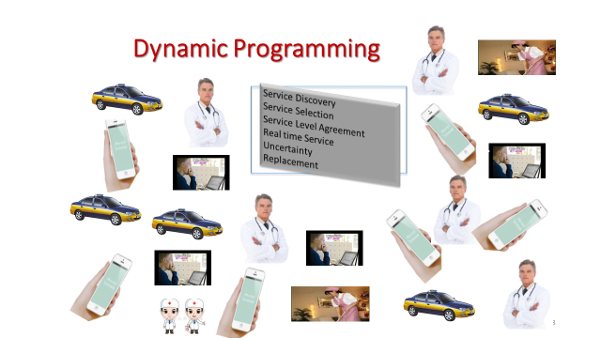
Q&A

Slide 26
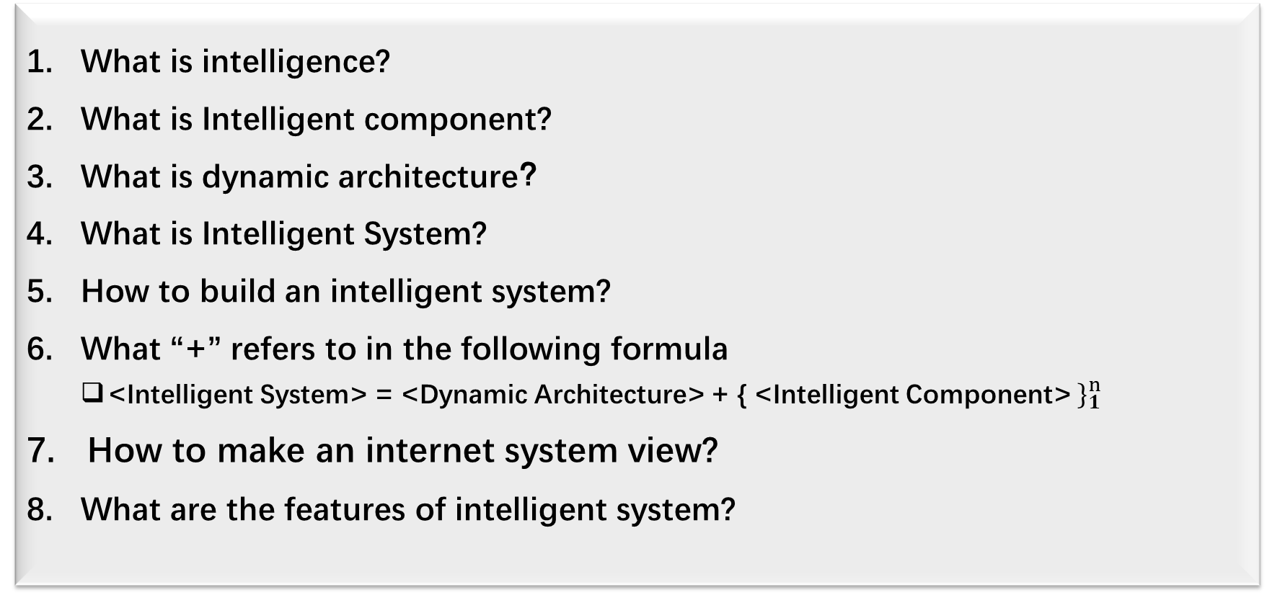
Q&A: Intelligent System
What is intelligence?
What is Intelligent component?
What is dynamic architecture？
What is Intelligent System?
How to build an intelligent system?
What “+” refers to in the following formula
<Intelligent System> = <Dynamic Architecture> + { <Intelligent Component> $\}_{1}^{n}$
How to make an internet system view?
What are the features of intelligent system?

Slide 27
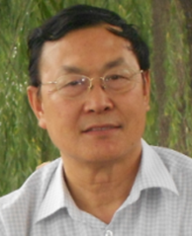
About Author
Mr. H. Li was director of CLEBA International Research, the Netherlands, who graduated from Peking University, Beijing, China and received PhD from Delft University of Technology, the Netherlands. He has about 30 years’ experience in the European academic and industry society.
Starting before 1990s he was engaged in academic research on software reuse and co-developed concepts and models of software reuse-in-the-large with Prof. J. van Katwijk Prof. M. Looijen and Prof. H. G. Sol of Delft University of Technology, the Netherlands. Later on he served for a strategic department of a major European company, planning software reuse strategies and chairing a project on re-architecting large and complex systems. He published a professional book on application reuse-in-the-large and presented keynote speeches in international conferences. Furthermore he had chaired an international research project for years on accurate machine translation, resulting a set of intellectual properties. His current research interests are on software development paradigm in the era of big data, regarding to the software development technology of dataization, intelligent, architecturalization and Intensification.

Slide 28
关于作者
李海宽博士毕业于北京大学，获荷兰代尔夫特理工大学博士学位，在欧洲学术界和工业界从事理论研究与工业实践凡30年。从上世纪90年代初开始，李海宽博士就从事人工智能、动态程序设计与软件复用的学术研究，与荷兰科学家、代尔夫特理工大学教授 J. van Katwijk、M. Looijen和H.G. Sol一起提出了大规模软件复用的概念和模型。之后，他在欧洲一家国际知名企业的战略部工作，负责策划软件战略并亲自主持基于机器学习的大型复杂系统重构项目。李海宽博士曾出版大规模软件复用技术相关专著并就所研究的内容多次在国际会议上发表主题演讲。近年来，在欧洲主持多项国际合作研究项目，涉及机器翻译、智能信息处理与跨语言电子商务等，其主要成果与项目核心技术已在荷兰登记注册，拥有自主知识产权。他目前的研究兴趣为大数据时代的软件开发范式（Paradigm)，涉及数据化，智能化，架构化与集约化等-系列软件开发的前沿技术。

